Slide 2
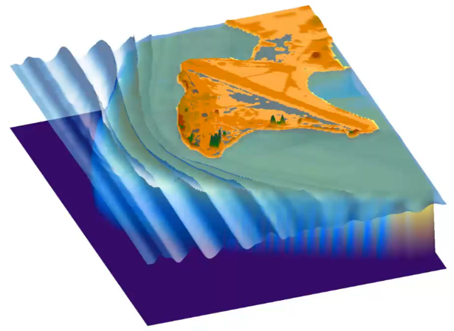
Numerical simulation of wave runup and coastal flooding in Roi-Namur.

Slide 3
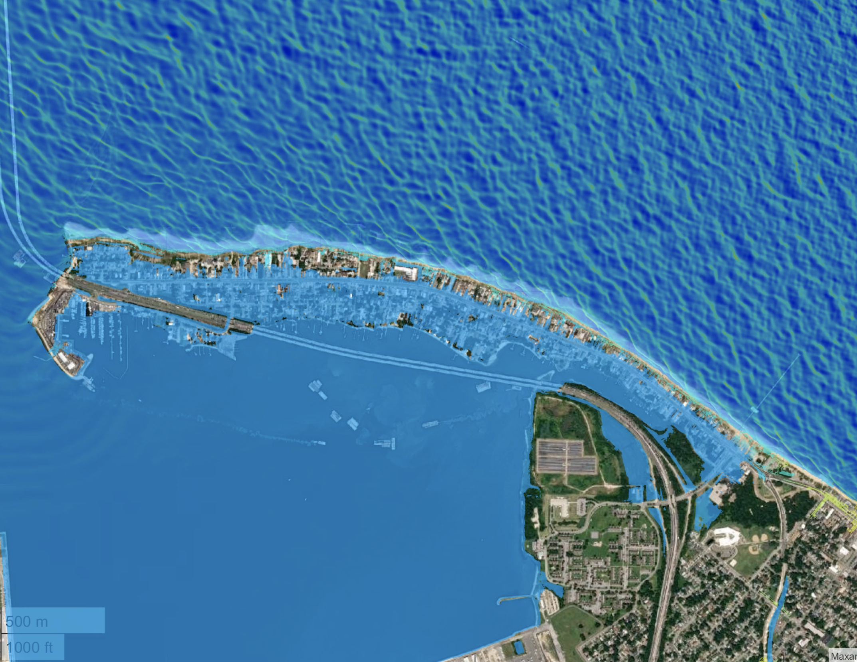
FUNWAVE simulation of Hurricane Irene
Click image for animation

Slide 4
About
Basic Model Info
Basic Model Info
User Guide
Sites
Interactive Map
Home
Demonstration
Animation
Team
Publication
Social Media
Websites

Slide 5
Home
About
Models
Guide
Sites
Interact-Map
Demo
Video
Publication
Media
Empirical
Empirical
Norfolk
Sites and Scenarios
Norfolk
Sites and Scenarios
Tyndall
Tyndall
Roi Namur
Roi Namur
CSHORE
CSHORE

Slide 6
